Slide 1
Internal Representation of Files

Slide 2
Contents
Introduction
Inodes
Structure of a regular file
Directories
Conversion of a path name to an inode
Super block
Inode assignment to a new file
Allocation of disk blocks
Other file types

Slide 3
Low – level File System Algorithms
The below low-level file system algorithms occupy the layer above the buffer cache algorithms
namei
alloc free ialloc ifree
iget iput bmap
buffer allocation algorithms
getblk brelse bread breada bwrite

Slide 4
File System Algorithms
File system algorithms, such as
iget – returns a previously identified inode, possibly reading it from disk via the buffer cache.
iput – releases the inode.
bmap – sets kernel parameters for accessing a file (Conversion of Byte Offset to Block Number)
namei – converts a user-level pathname to an inode, using the algorithm iget, iput and bmap.
alloc and free – allocate and free disk blocks for files.
ialloc and ifree – assign and free inodes for files.

Slide 5
Inode
Every file on a Unix system has a unique inode.
Inode contains the information necessary for a process to access a file, such as
file ownership,
access rights,
file size, and
location of the file’s data in the file system.

Slide 6
Inode
Processes access files by a well defined set of system calls and specify a file by a character string i.e. the path name.
Each pathname uniquely specifies a file, and the kernel converts the pathname to the file’s inode.
Inode exists in a static form on disk and the kernel reads them into an in-core inode to manipulate them

Slide 7
Contents of Disk Inodes
Disk inodes consists of the following fields:
File owner identifier:
Ownership is divided between an individual owner and a group owner and defines the set of users who have access rights to a file
The super user has access rights to all files in the system
File type:
Files may be of type, regular, directory, character or block special, or FIFO (pipes)

Slide 8
Contents of Disk Inodes
File access permissions:
The system protects files according to three classes: the owner, and the group owner of the file, and other users; each class has access right to read, write and execute the file, which can be set individually
File access times:
Giving the time the file was last modified, where it was last accessed, and when the inode was last modified

Slide 9
Contents of Disk Inodes
Number of links to the file:
Representing the number of names the files has in the directory hierarchy
Table of contents for the disk addresses of data in a file.
Users treats the data in a file as a logical stream of bytes
Kernel saves the data in discontiguous disk blocks
The inode identifies the disk blocks that contains the file’s data
The inode does not specify the pathname(s) that access the file

Slide 10
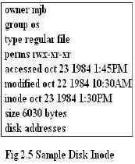
Contents of Disk Inodes
File size:
Data in a file is addressable by the number of bytes from the beginning of the file, starting from byte offset 0, and the file size is 1, greater the highest byte offset of data in the file.
e.g. if user creates a file and writes only 1 byte of data at byte offset 1000 in the field, the size of the file is 1001 bytes.

Slide 11
Contents of Disk Inodes
This inode is that of a regular file owned by “mjb”, which contains 6030 bytes. The system permits “mjb” to read, write or execute the file; members of the group “os” and all other user can only read or execute the file, not write it.
The last time anyone read the file was on October 23, 1984 at 1:45 in the afternoon, and last time anyone wrote the file was on October 22, 1984, at 10:30 in the morning. The inode was last changed on October 23, 1984 at 1:30 in the afternoon, although the data in the file was not written at that time
The kernel encodes the above information in the inode.

Slide 12
Inodes
Distinction between writing the contents of an inode to disk and writing the contents of a file to disk:
The contents of a file change only when writing it.
The contents of an inode change when changing the contents of a file or when changing its owner, permission or link settings
Changing the contents of a file automatically implies a change to the inode
But changing the inode does not imply that the contents of the file change.

Slide 13
In-core Inode
The in-core copy of the inode contains the following fields in addition to the fields of disk inode
The status of the in-core inode, indicating whether
the inode is locked
a process is waiting for the inode to become unlocked
The in-core representation of inode differs from the disk copy as a result of a change to the data in the inode.
The in-core representation of file differs from the disk copy as a result of a change to the file data.
The file is a mount point
The logical device number of the file system that contains the file.

Slide 14
In-core Inode
The inode number
Since inode are stored in a linear array on disk, the kernel identifies the number of disk inode by its position in the array.
Pointers to other in-core inodes
The kernel links inodes on hash queues and on a free list in the same way that it links buffers on buffer hash queues and on the buffer free list.
A hash queue is identified according to the inode’s logical device number and inode number
The kernel can contain at most one in-core copy of a disk inode, but inodes can be simultaneously on a hash queue and on the free list.
A reference count, indicating the number of instances of the file that are active. (Such as when opened).

Slide 15
In-core inode and buffer header
The management of inodes is similar to the management of buffers
The inode lock, when set, prevents other processes form accessing the inode
Other processes set a flag in the inode when attempting to access it to indicate that they should be awakened when the lock is released
The kernel sets other flags to indicate discrepancies between the disk inode and the in-core copy
When the kernel needs to record change to the file or to the inode, it writes the in-core copy of the inode to disk after examining these flags

Slide 16
In-core inode and buffer header
Difference between an in-core inode and a buffer header is the “reference count”
Reference count – counts the number of active instances of the file
An inode is active when a process allocates it, such as opening a file
An inode is on the free list only if its reference count is 0, meaning that the kernel can reallocate the in-core inode to another disk inode
The free list of inodes thus serves as a cache of inactive inodes

Slide 17
In-core inode and buffer header
If a process attempts to access a file whose inode is not currently in the in-core inode pool, the kernel reallocates an in-core inode from the free list for its use
On the other hand a buffer has no reference count; it is on the free list if and only if it is unlocked.

Slide 18
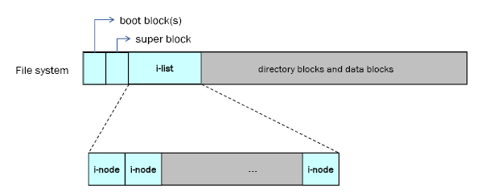
UNIX File System Overview

Slide 19
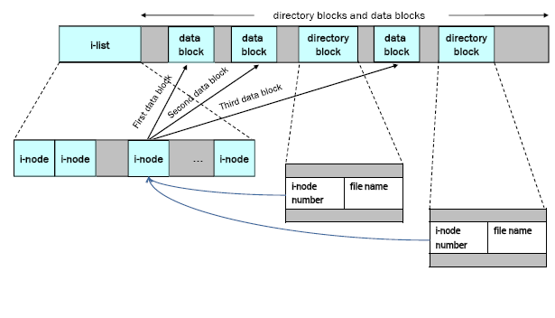
File System Layout

Slide 20
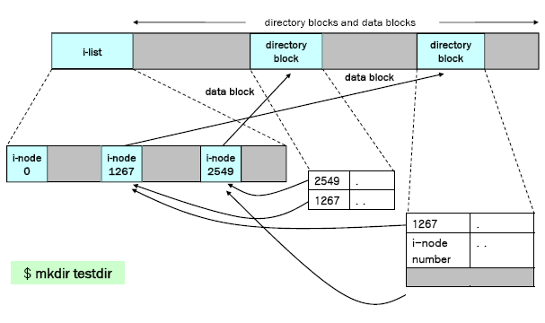
Sample File System

Slide 21
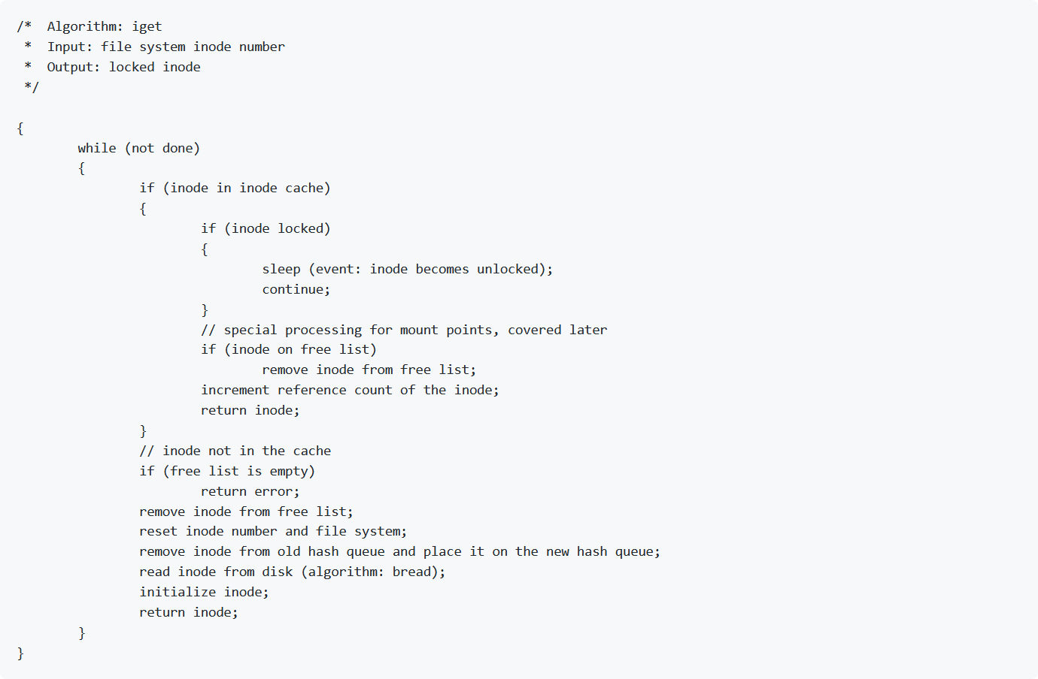
Accessing Inodes : iget

Slide 22
Accessing Inodes : iget
The kernel identifies particular inodes by their file system and inode number
The kernel allocates in-core inodes at the request of higher-level algorithms.
The algorithm iget allocates an in-core copy of an inode.
The kernel maps the device number and inode number into a hash queue and searches the queue for the inode.
If it cannot find the inode, it allocates one from the free list and locks it.

Slide 23

Accessing Inodes : iget
The kernel then prepares to read the disk copy of the newly accessed inode into the in-core copy.
It already knows the inode number and logical device and computes the logical disk block that contains the inode according to how many disk inodes fit into a disk block.
The computation follows the formula

Slide 24
Accessing Inodes : iget
For Example:
Assuming
Start block of inode list = 2
Number of inode per block = 8
To find the disk block of inode number 8, compute
block num (disk block) = ((8-1)/8)+2
= (7/8)+2
= 0+2 = 2
Then inode number 8 is in disk block 2

Slide 25

Accessing Inodes : iget
When the kernel knows the device and disk block number, then the formula to compute the byte offset of the inode in the block
For example: Assume
Each disk inode occupies 64 bytes
8 inodes per disk block, so disk block size = 8*64=512 bytes, then
Byte offset of the inode 8 in the block = ((8-1)%8)*64=448
Inode number 8 starts at byte offset 448 in the disk block.

Slide 26
Accessing Inodes : iget
The kernel removes the in-core inode from the free list, places it on the correct hash queue, and set its in-core reference count to 1.
It copies the file type, owner fields, permission settings, link count, file size, and the table of contents from the disk inode to the in-core inode, and returns an locked inode.

Slide 27
Accessing Inodes : iget
The kernel manipulates the inode lock and reference count independently.
The lock is set during execution of a system call to prevent other processes from accessing the inode while it is in use.
The kernel releases the lock at the conclusion of the system call. An inode is never locked across the system calls.
The kernel increments the reference count for every active reference to a file.

Slide 28
Accessing Inodes : iget
For example:
The kernel increments the inode reference count when a process opens a file.
It decrements the reference count only when reference become inactive (when process closes a file).
The reference count thus remains set across multiple system call.
The lock is free between system calls to allow processes to share simultaneous access to a file;

Slide 29
Accessing Inodes : iget
The reference count remains set between system calls to prevent the kernel from reallocating an active in-core inode.
Thus, the kernel can lock and unlock an allocated inode independent of the value of the reference count.
The system calls other than open, allocates and release inode.

Slide 30
Accessing Inodes : iget
In algorithm iget
If the kernel attempts to take an inode from free list but finds the free list empty, it reports an error.
This is different from, the kernel follows for disk buffers
Where a process sleeps until a buffer becomes free
Processes have control over the allocation of inodes at user level via execution of open and close system calls, and consequently the kernel cannot guarantee when an inode will become available.

Slide 31
Accessing Inodes : iget
Therefore, a process that goes to sleep waiting for a free inode to become available may never wake up.
Rather than leave such a process hanging, the kernel fails the system call.
Processes do not have control over buffers:
Because a process cannot keep a buffer locked across system calls, the kernel can guarantee that a buffer will become free soon, and a process therefore sleeps until one is available.

Slide 32
Accessing Inodes : iget
If inode is in the cache, the process (A) would find it on its hash queue and check if the inode was currently locked by another process (B).
If the inode is locked, process A sleeps, setting a flag in the in-core inode to indicate that it is waiting for the inode to become free.
When process B later unlocks the inode, it awaken all processes (including process A) waiting for the inode to become free.

Slide 33
Accessing Inodes : iget
When process A is finally able to use the inode, it locks the inode so that other processes cannot allocate it.
If the reference count was previously 0, the inode also appears on the free list, so the kernel removes it from there: the inode is no longer free.
The kernel increments the inode reference count and returns a locked inode

Slide 34
Accessing Inodes : iget
Summary:
The iget algorithm is used toward the beginning of system calls when a process first accesses a file.
The algorithm returns a locked inode structure with reference count 1 greater than it had previously been.
The in-core inode contains up-to-date information on the state of the file.
The kernel unlocks the inode before returning the system call so that other system calls can access the inode if they wish.

Slide 35
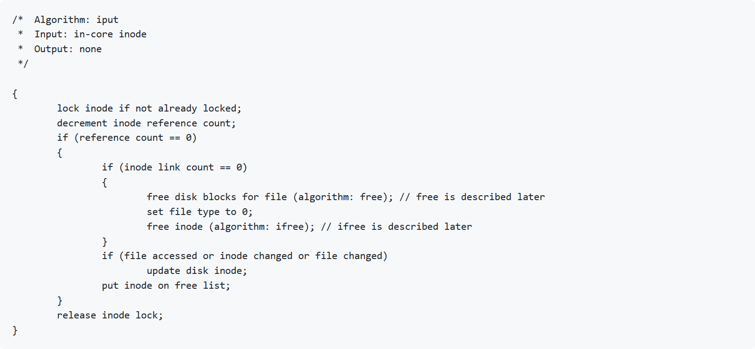
Releasing Inodes:iput

Slide 36
Releasing Inodes:iput
When the kernel releases an inode (iput), it decrements its in-core reference count.
If the count drops to 0, the kernel writes the inode to disk if the in-core copy differs from the disk copy.
They differ if the file data has changed, or if the file owner or access permission have changed.
The kernel places the inode on the free list of inodes, effectively caching the inode in case it is needed again soon.
The kernel may also release all data blocks associated with the file and free the inode if the number of links to the file is 0.

